Slide 1
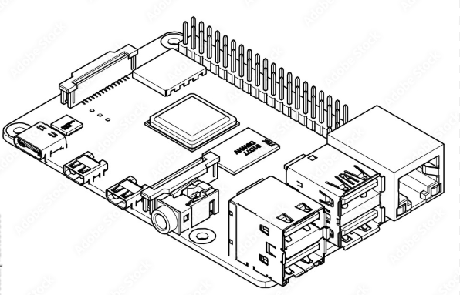


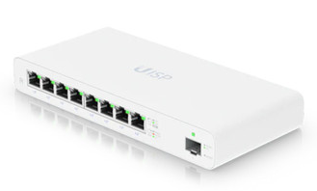
RaspberryPi
CSI
ethernet
1
RaspberryPi
3
2
CSI
ethernet
RaspberryPi
Master PC
CSI
4
CSI
ethernet
RaspberryPi
ethernet
ethernet
ethernet switch

